Slide 1
EDUTATIVE
Presented By:
L14-4021 Rida Bari
L14-4035 Waqar Ali
L14-4087 Qandeel Mushtaq
L14-4304 Zainab Iftikhar

Slide 2
Problem Statement
According to a study conducted by NEMIS (National Education Management Information System), the total enrolment of students at higher secondary schools is 1.246 million. That means about a million confused students unsure about the major they want to pursue and the appropriate university for that. The confusion leads to frustration, disorder, and rushed decisions about one’s future sometimes transforming into four years of regret.

Slide 3
Client Information
Hassan Shahid is an entrepreneur and a LUMS Alumni. He is a founder of successful startup named Kickstart. In the next couple of years, Hassan hopes to expand his vision by opening Kickstart’s offices in all the major cities of Pakistan with all major startups utilizing its services to transform their ambitions into realities. Besides managing Kickstart, Hassan is also engaged in working on ‘Edutative’ which is collaborating with 40 top universities in Pakistan to create a forum where students could easily look for solutions in their respective field of study which would help them prepare efficiently along with regular tracking of their progress.

Slide 4
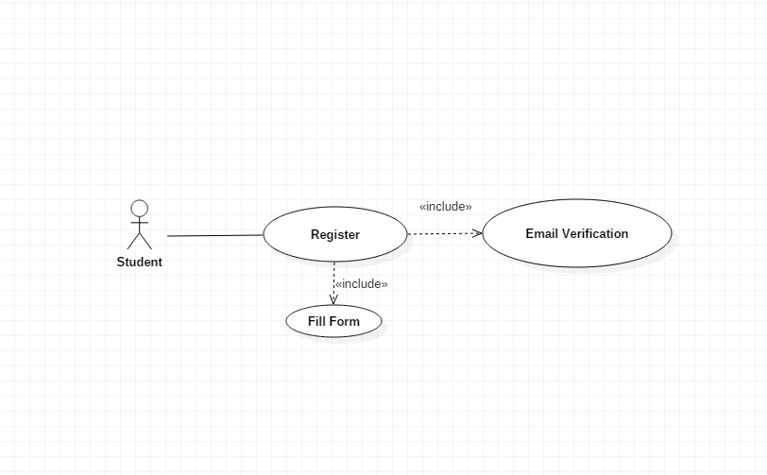
Register use case
Use Case: Register Identifier: UC4 Related Requirements: FR1. The system shall be able to register new users. Initiating Actor: Student Participating Actor: Email Service Actor’s Goal: To register a new account Preconditions: The student has no account & is on Homepage. Trigger: Student clicks on Signup Button on Homepage Post-conditions: The student has successfully created a new account.

Slide 5
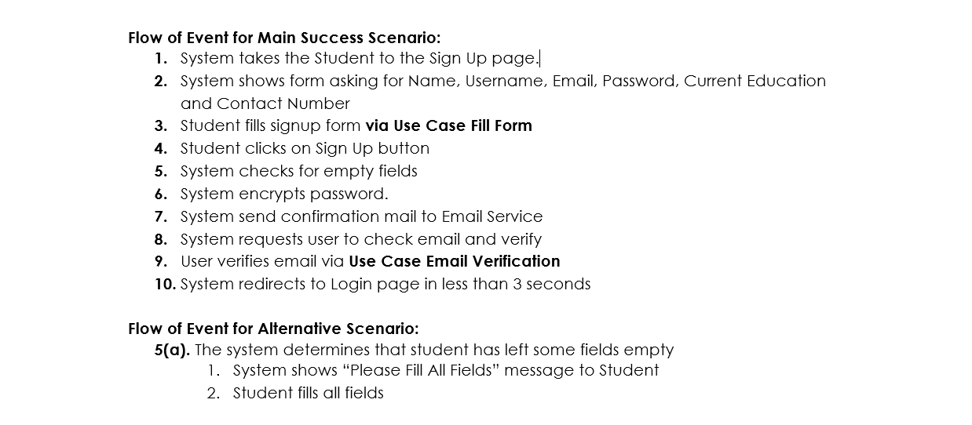

Slide 6
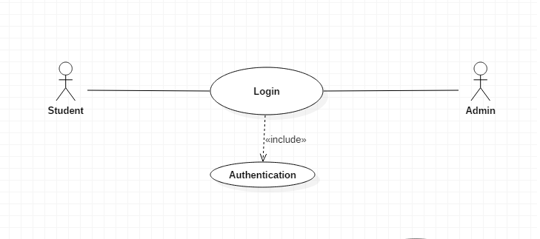
Login use case
Use Case: Login Identifier: UC1 Related Requirements: The system shall let member/admin log in (FR2) Initiating Actor: Student, Admin Participating Actor: Actor’s Goal: To Log into the system and access functions of system Preconditions: The User has an authenticated account Trigger: The User requests to login by clicking on Login Button on Homepage Post-conditions: The user is successfully logged in.

Slide 7
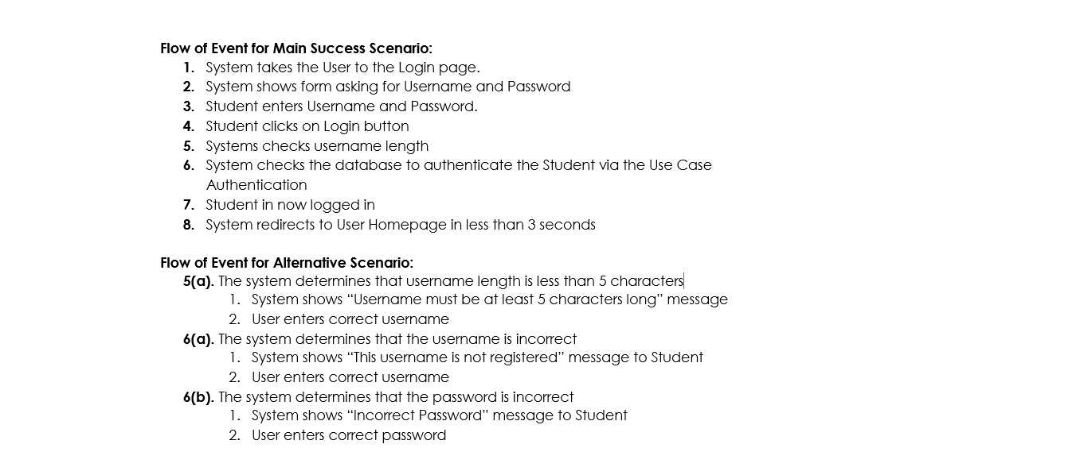

Slide 8
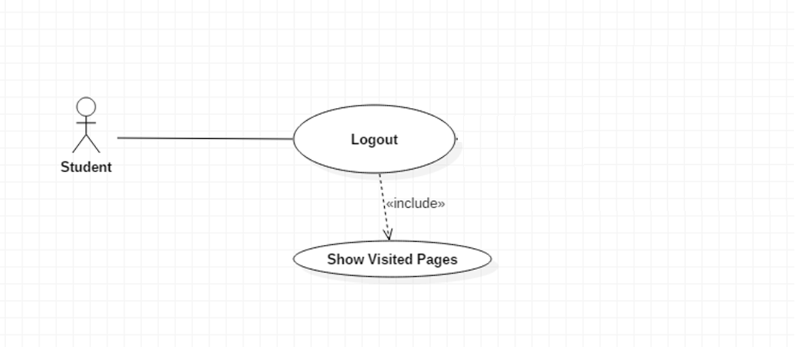
Log out use case (for student)
Use Case: Logout Identifier: UC2 Related Requirements: The system shall let the users log out. (FR7) Initiating Actor: Student Participating Actor: Actor’s Goal: To Log out of the system Preconditions: The student is already Logged In Trigger: Student requests to logout by clicking on Logout Button on Page Header Post-conditions: The student is successfully logged out.

Slide 9
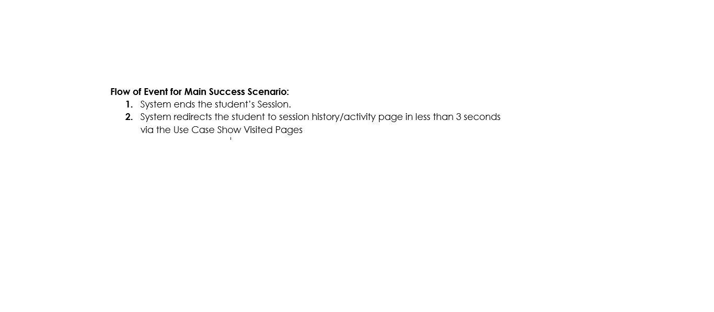

Slide 10
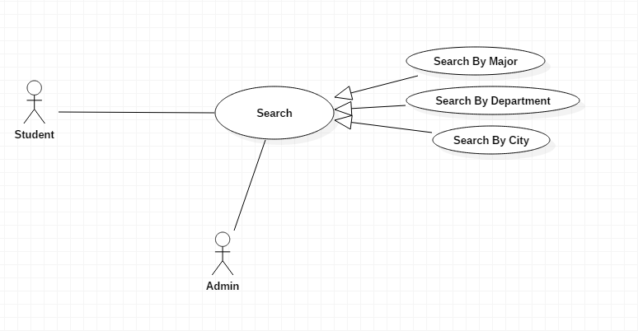
Search use case
Related Requirement : F3

Slide 11
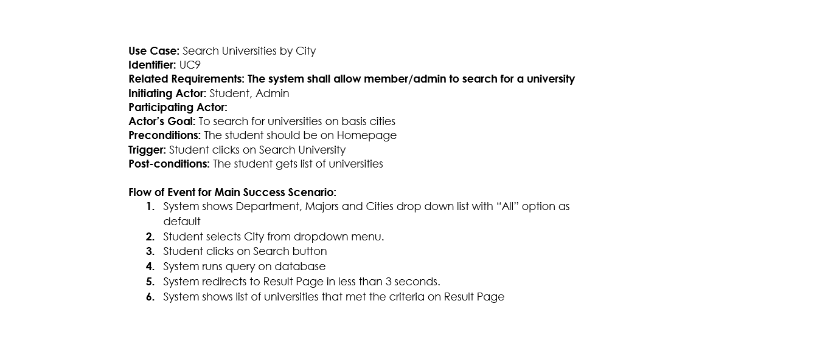

Slide 12
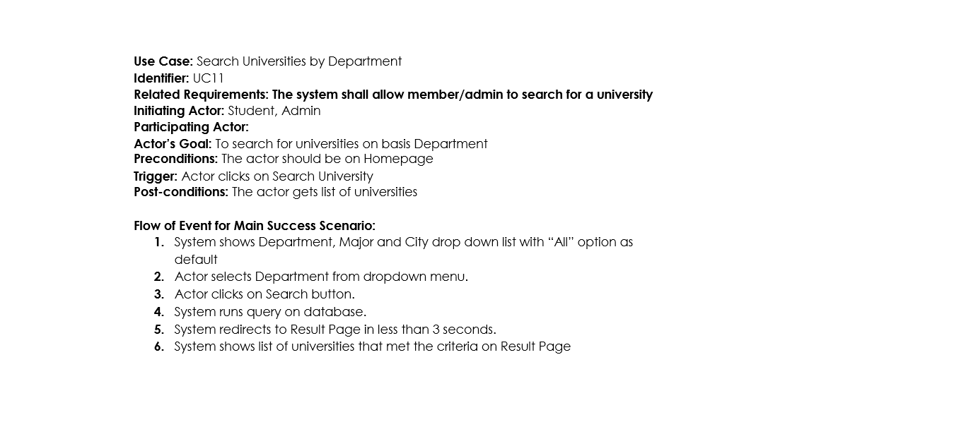

Slide 13
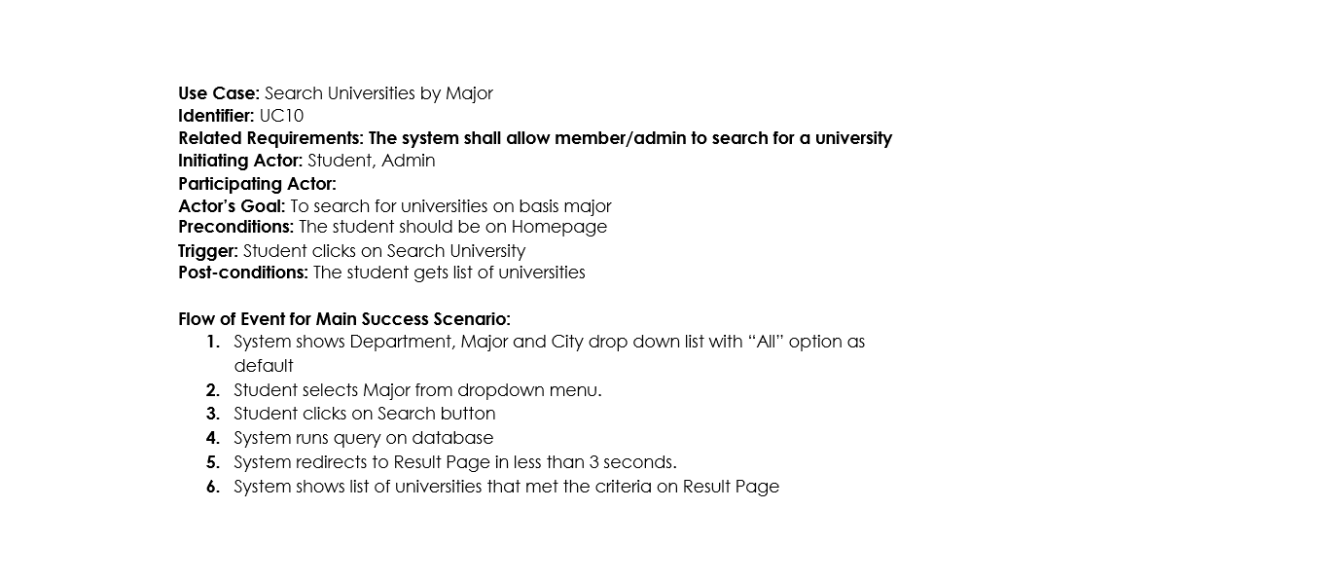

Slide 14
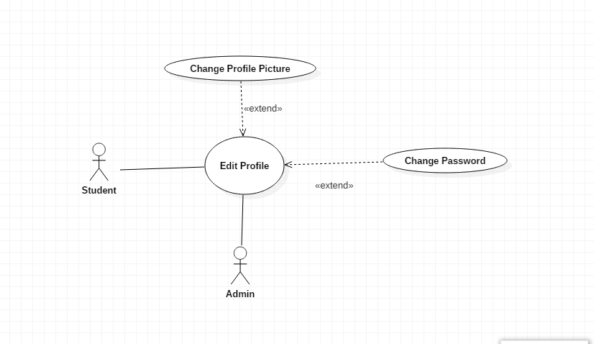
Edit Profile use case
Use Case: Edit Profile Identifier: UC6 Related Requirements: The system shall allow members/admin to edit their profiles (FR4) Initiating Actor: Student, Admin Participating Actor: Actor’s Goal: To edit User personal profile information Preconditions: The User is Logged In Trigger: The User requests to edit profile by clicking on Edit Profile Button on Header Post-conditions: The User has successfully made changes in profile.

Slide 15
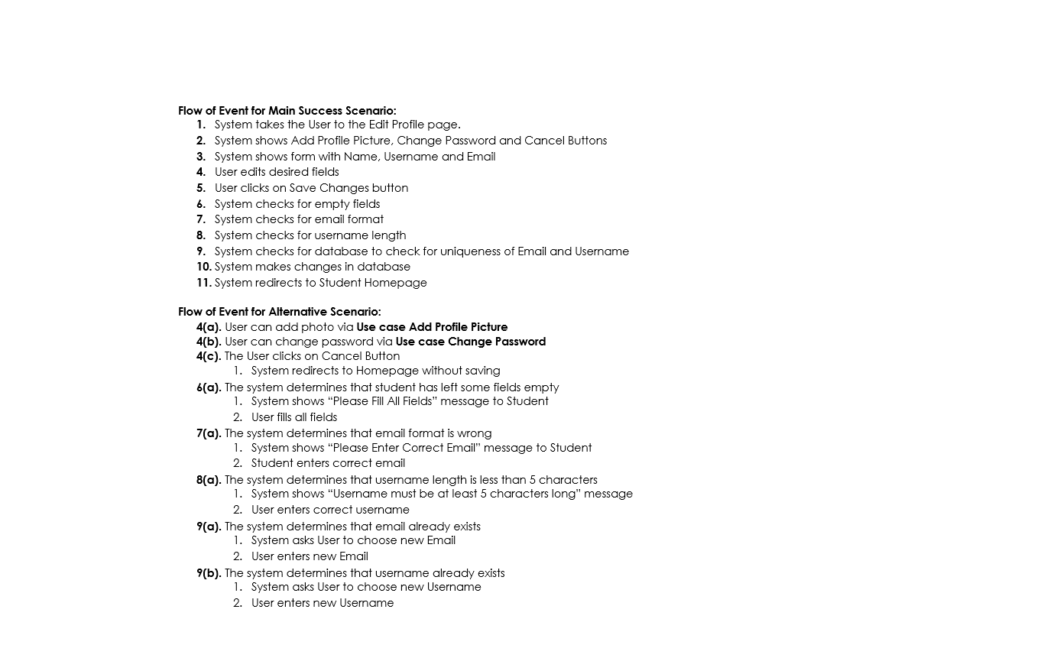

Slide 16
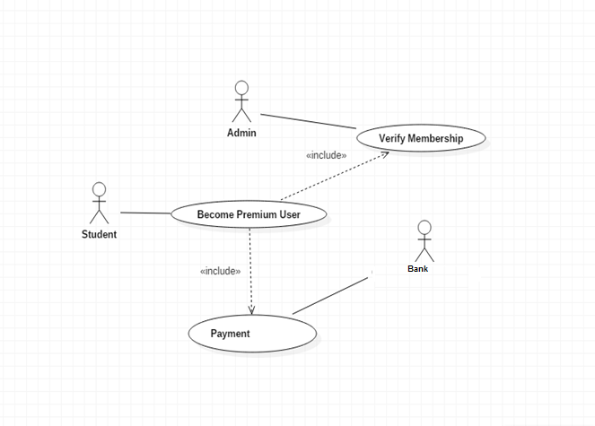
Become Premium Member use case
Use Case: Become Premium Member Identifier: UC12 Related Requirements: The system shall allow members to upgrade to premium members (FR6) Initiating Actor: Student Participating Actor: Admin, Bank Actor’s Goal: To become a premium member and access exclusive features Preconditions: The student should be Logged In. The student should be an Ordinary User/Member Trigger: Student clicks on Premium Member Button on Header Post-conditions: The student role is successfully changed to premium member

Slide 17
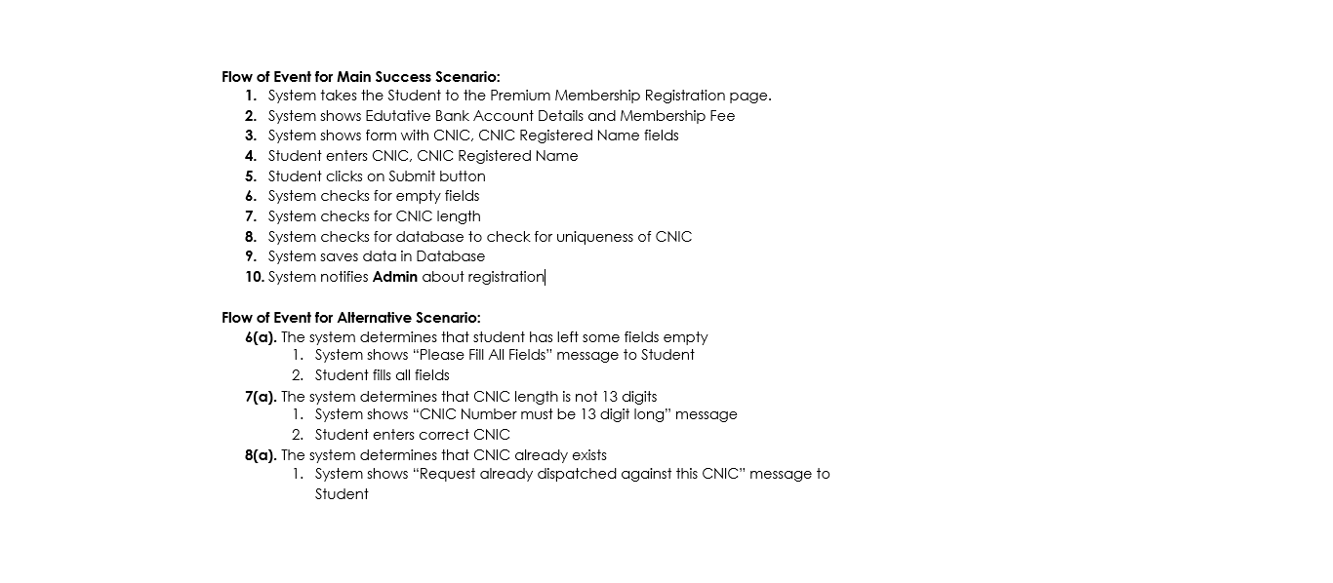

Slide 18
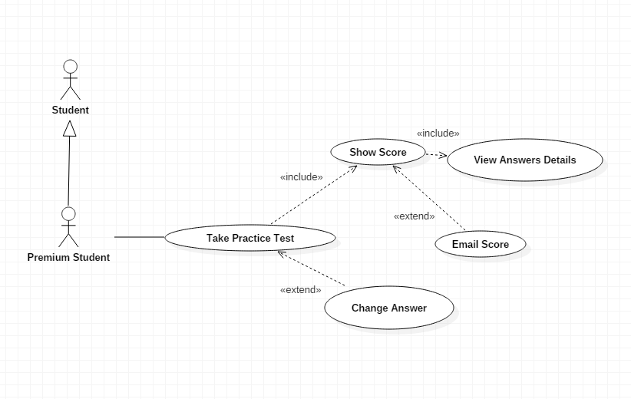
Take Practice Test use case
Use Case: Take Practice Test Identifier: UC13 Related Requirements: The system shall allow members to take test (FR5) Initiating Actor: Premium Student Participating Actor: Actor’s Goal: To practice for university entry exams Preconditions: The student should be Logged In. The student should be a Premium User/Member. Each Subject has at least 50 questions in database Trigger: Student clicks on Take Test Button on Header Post-conditions: Test is taken and the score is displayed.

Slide 19
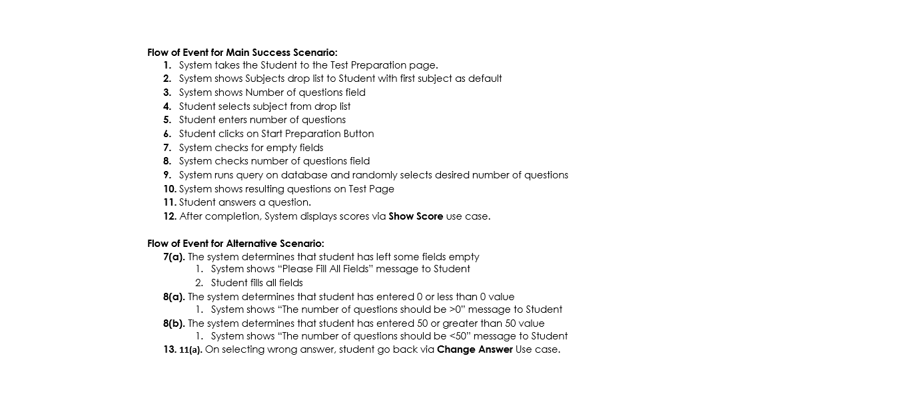

Slide 20
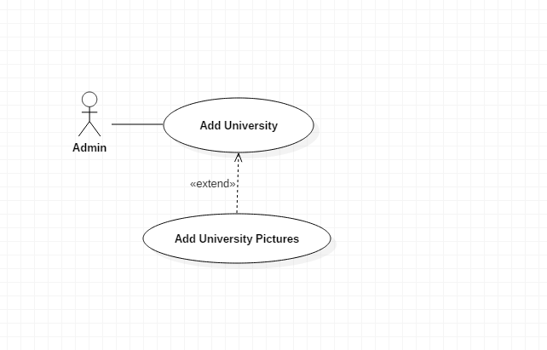
Add university use case
Use Case: Add University Identifier: UC14 Related Requirements: The system shall let admin add university in the database (FR8) Initiating Actor: Admin Participating Actor: Actor’s Goal: To add a new university to the Edutative website Preconditions: The Admin is already Logged In Trigger: Admin requests to add new university by clicking on Add University button. Post-conditions: The admin has successfully added a new university.

Slide 21
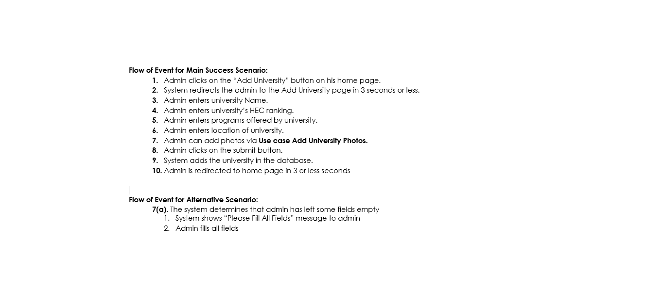

Slide 22
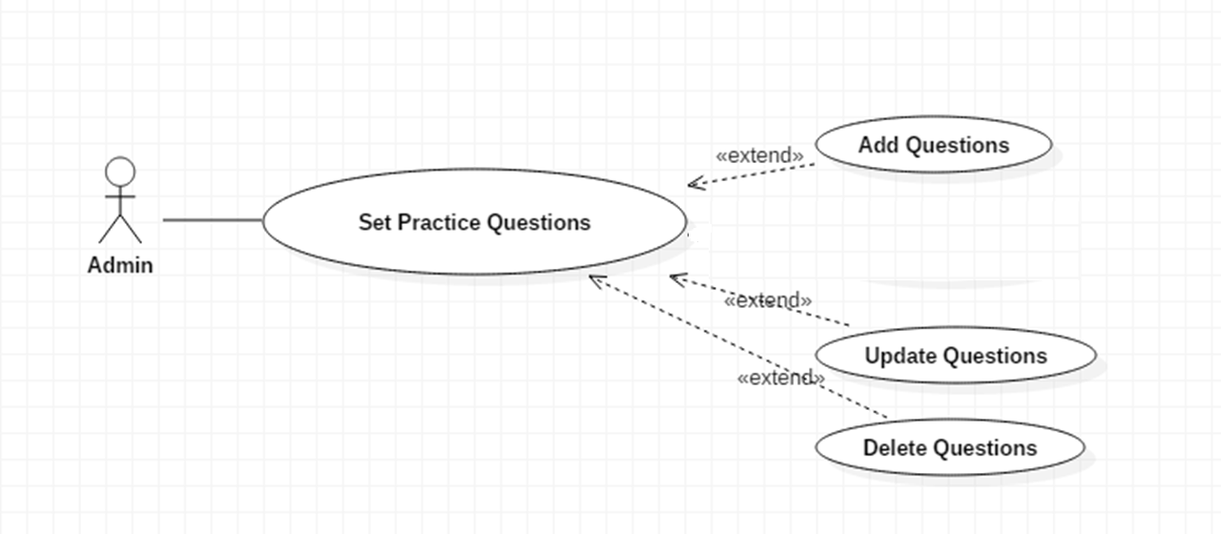
Set Practice Question use case

Slide 23
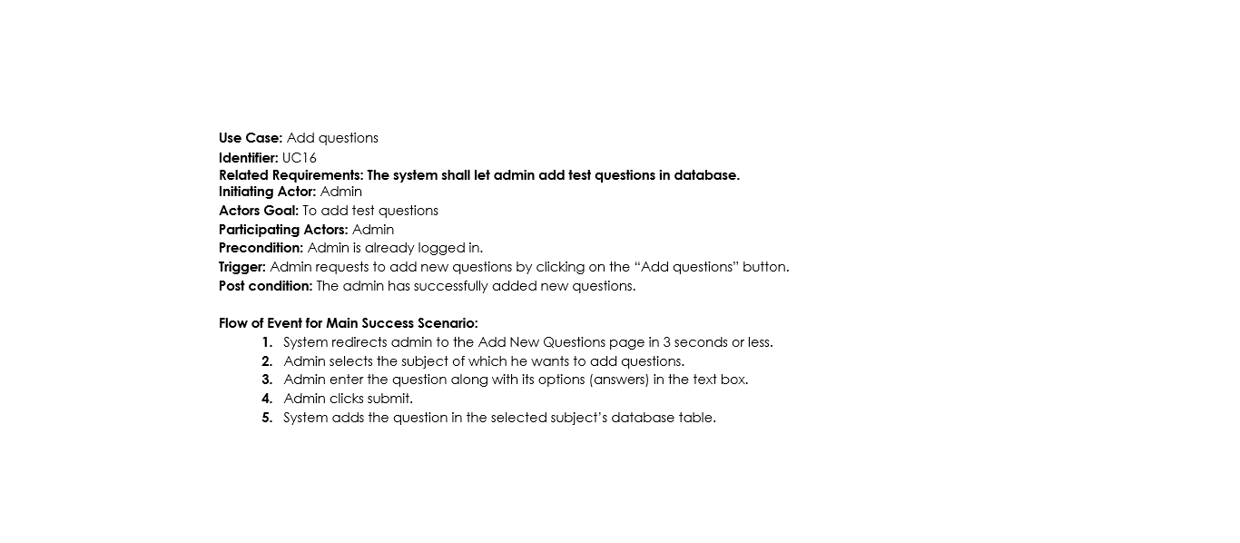
Related Requirement: FR11

Slide 24
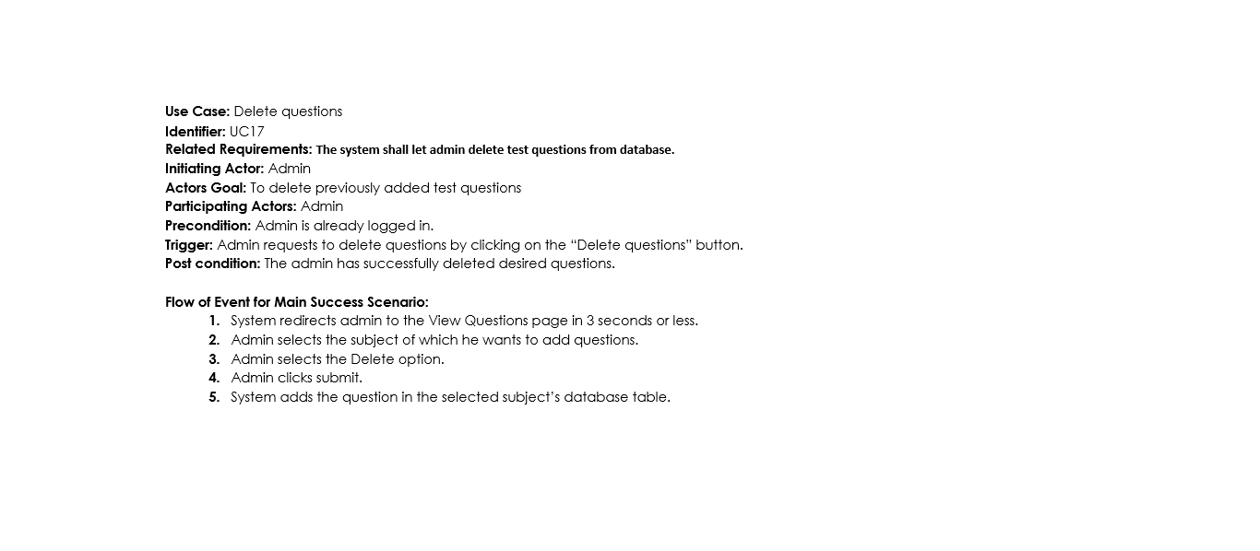
Related Requirement: FR12

Slide 25
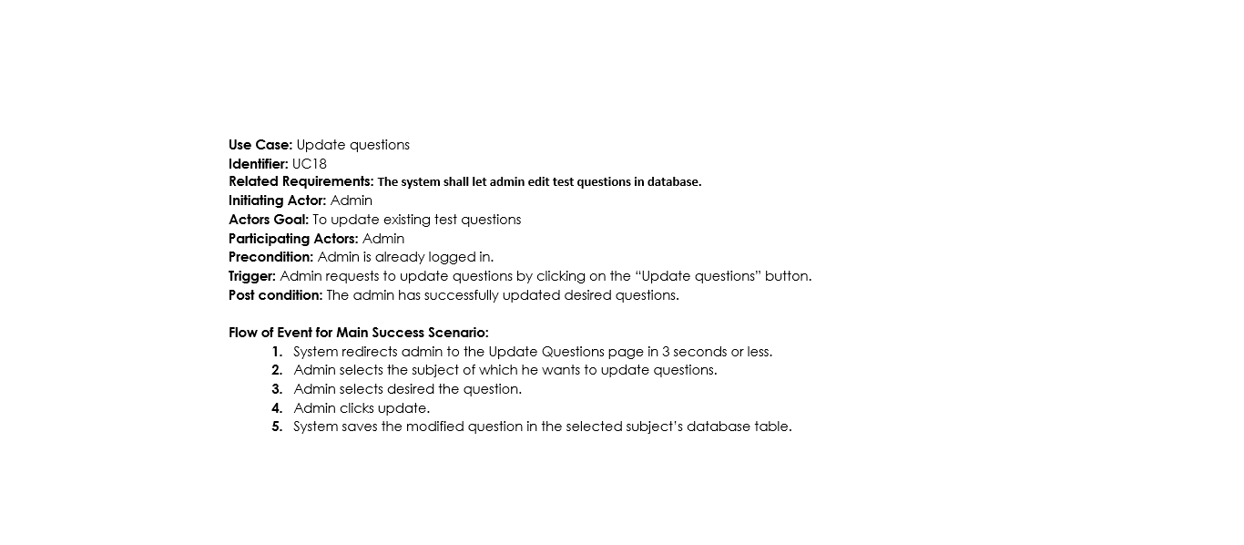
Related Requirement: FR13

Slide 26
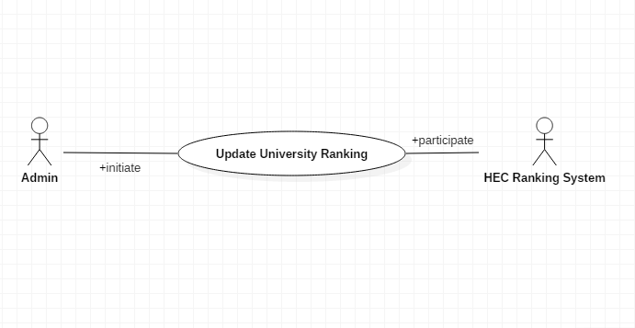
Update University Rankings use case
Use Case: Update Universities Rankings Identifier: UC19 Related Requirements: The system shall let admin update university ranking. (FR10) Initiating Actor: Admin Actors Goal: To update the university rankings Participating Actors: Admin Precondition: Admin is logged in. Trigger: Admin requests to update the university rankings by clicking on the “Update rankings” button. Post condition: The admin has successfully updated the rankings.

Slide 27
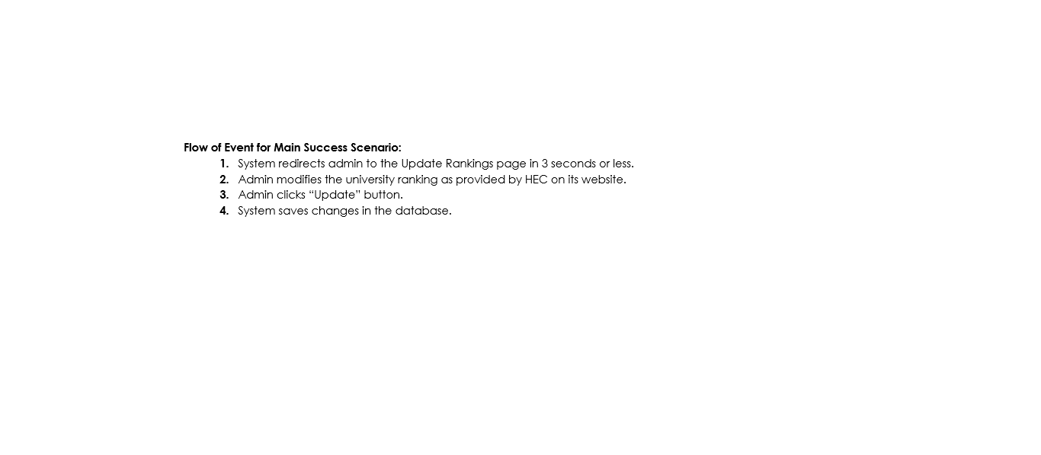

Slide 28
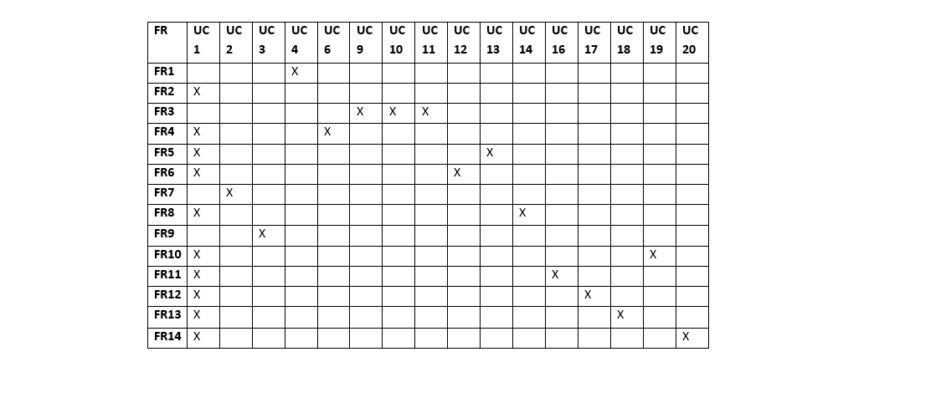
Traceability Matrix

